Slide 1
Mathematic for Computer Science - III CS203B
Lecture 2:
Fundamentals of Elementary Probability Theory - I

Slide 2
Elementary probability theory
It is so simple that you underestimate its elegance and power

Slide 3




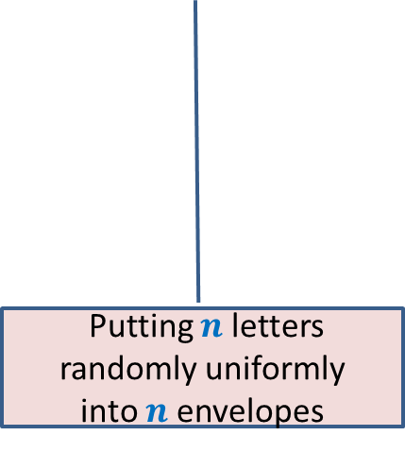
A Random Experiment
Experiment results in one of many possible outcomes.
Outcome will always be from a specified set.
Likelihood of each possible outcome is non-negative.
We are interested in a collection of outcomes.
How to capture these rules/facts in probability theory?
Tossing a coin 5 times
Throwing 3 dices
Putting $n$ letters randomly uniformly
into $n$envelopes

Slide 4
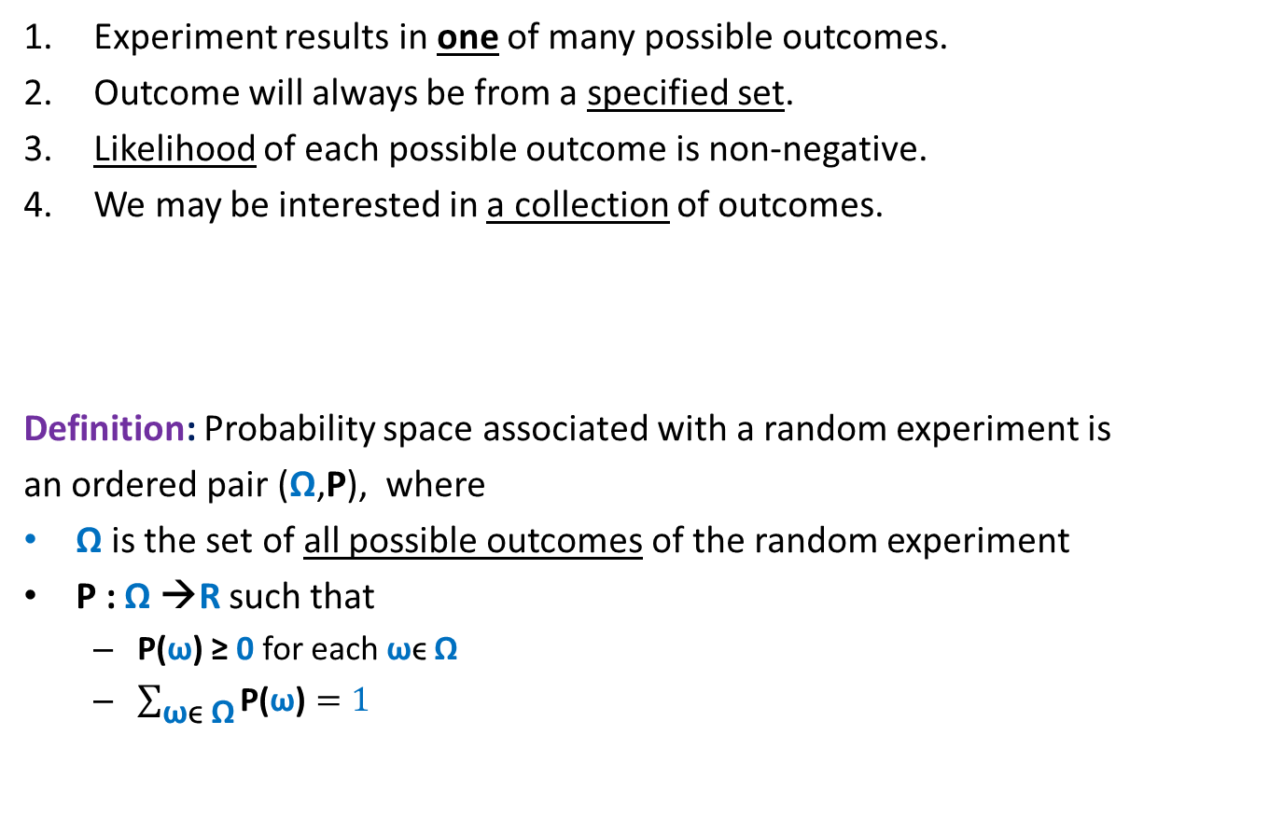
Probability Space
Experiment results in one of many possible outcomes.
Outcome will always be from a specified set.
Likelihood of each possible outcome is non-negative.
We may be interested in a collection of outcomes.
Definition: Probability space associated with a random experiment is
an ordered pair (Ω,P), where
Ω is the set of all possible outcomes of the random experiment
P : Ω →R such that
P(ω) ≥ 0 for each ωϵ Ω
$\sum_{\text{ω}\text{ϵ} \text{Ω}}{\text{P}\text{(}\text{ω}\text{)}}=1$
Ω is called sample space.

Slide 5
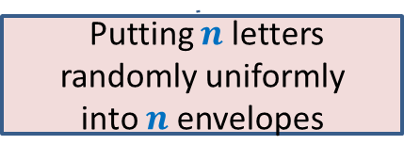
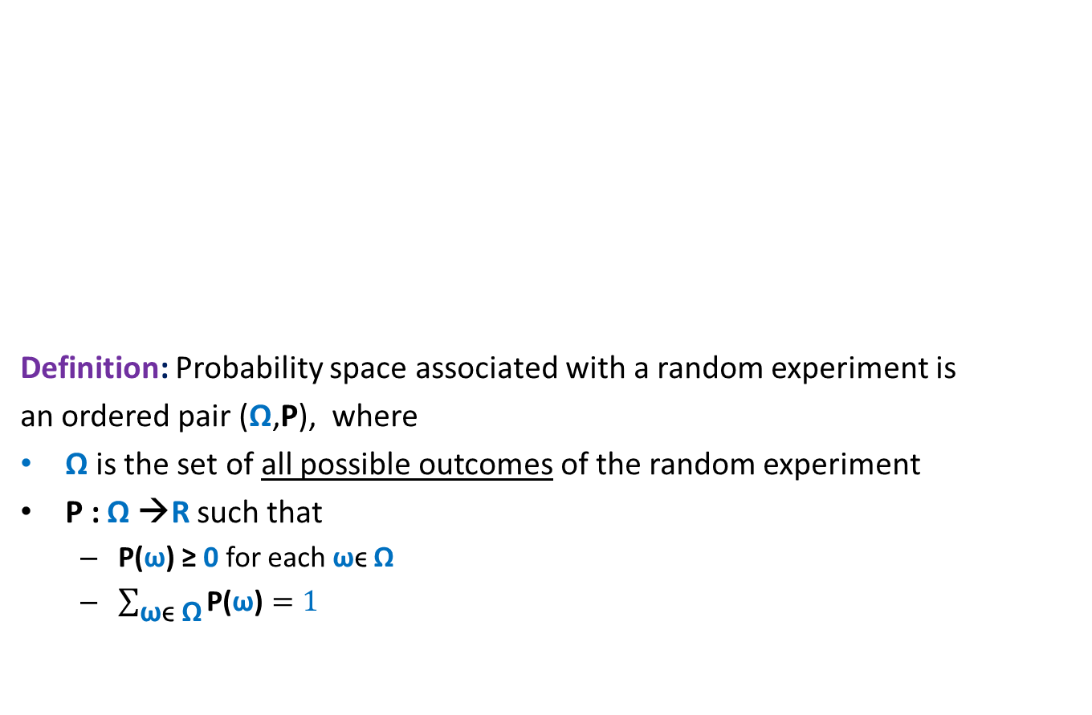



Probability Space
Elementary events (outcomes)
|Ω|
Tossing a coin 5 times
$$2^{5}$$
Definition: Probability space associated with a random experiment is
an ordered pair (Ω,P), where
Ω is the set of all possible outcomes of the random experiment
P : Ω →R such that
P(ω) ≥ 0 for each ωϵ Ω
$\sum_{\text{ω}\text{ϵ} \text{Ω}}{\text{P}\text{(}\text{ω}\text{)}}=1$
In this course we shall mainly deal with Discrete Probability Theory. This theory studies the random experiments whose sample spaces are finite or countably infinite.
Throwing 3 dices
$$6^{3}$$
Ω
Putting $n$ letters randomly uniformly
into $n$envelopes
$$n!$$

Slide 6




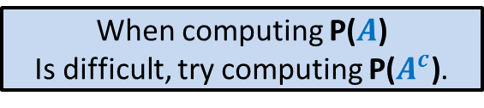
Event in a Probability Space
Definition: An event A in a probability space (Ω,P) is a subset of Ω.
The probability of event $A$ is defined as
$$\sum_{\text{ω}\text{ϵ} \text{A}}{\text{P}\text{(}\text{ω}\text{)}}$$
Ω
A
$\text{P}\text{(}A\text{)}$ =
Where to use this formula ?
$A^{c}$ = complement of $A$.
$$\text{P}\text{(}A^{c}\text{)}\text{= }1− \text{P}\text{(}A\text{)}$$
When computing $\text{P}\text{(}A\text{)}$
Is difficult, try computing $\text{P}\text{(}A^{c}\text{)}$.

Slide 7
An Important Advice
For solving a problem involving probability,
Fully understand the underlying sample space.
Define and understand the corresponding event properly.

Slide 8
Union of Events

Slide 9






Union of two Events
Given two events $A$ and$B$ defined over a probability space ($Ω$,P),
what is P($A$U$B$) ?
Consider any ω ϵ $A$U$B$
P($A$U$B$) $=$ P($A$) + P($B$) $−$ P($A$∩$B$)
$$A$$
$$B$$
Ω
Contribution in the R.H.S.
ω belongs to exactly one of $A$ and $B$
P(ω)
ω belongs to both $A$ and $B$
P(ω)

Slide 10

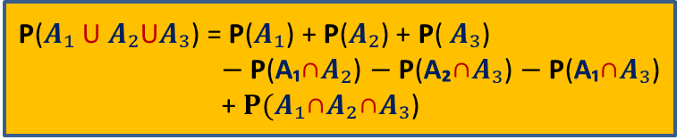






Union of three Events
Given three events $A₁$, $A₂$, $A₃$, defined over a probability space ($Ω$,P),
what is P($A₁$U $A₂$U $A₃$) ?
Consider any ω ϵ $A₁$U $A₂$U$A₃$
P($A₁$U $A₂$U$A₃$) = P($A₁$) + P($A₂$) + P( $A₃$)
$−$ P(A₁∩$A₂$) $−$P(A₂∩$A₃$) $−$P(A₁∩$A₃$)
+ $P(A₁$∩$A₂$∩$A₃$)
$$A₁$$
$$A₂$$
$$A₃$$
Ω
Contribution in the R.H.S.
ω belongs to exactly one of $A₁$, $A₂$, $A₃$
P(ω)
ω belongs to exactly two of $A₁$, $A₂$, $A₃$
P(ω)
ω belongs to each of $A₁$, $A₂$, $A₃$
P(ω)

Slide 11

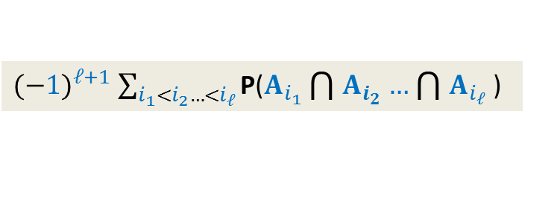
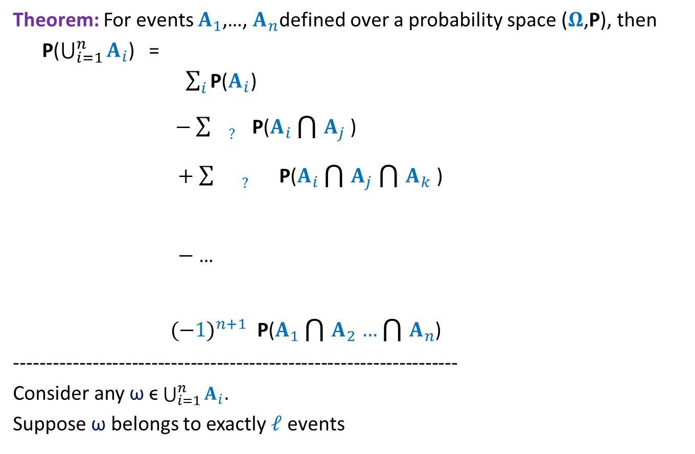












Union of $n$ Events
Theorem: For events $A_{1}$,…, $A_{n}$defined over a probability space ($Ω$,P), then
P($\bigcup_{i=1}^{n}{A_{i}}$) =
$\sum_{i}{\text{P}\text{(}A_{i}\text{)}}$
$−$ $\sum_{ ? }{\text{P}\text{(}A_{i}\bigcap{A_{j}}\text{)}}$
$+$ $\sum_{ ? }{\text{P}\text{(}A_{i}\bigcap{A_{j}}\bigcap{A_{k}}\text{)}}$
$−$ …
${(−1)}^{n+1}$ $\text{P}\text{(}A_{1}\bigcap{A_{2}}…\bigcap{A_{n}}$)
--------------------------------------------------------------------
Consider any ω ϵ $\bigcup_{i=1}^{n}{A_{i}}$.
Suppose ω belongs to exactly $ℓ$ events
$$\left({ℓ \atop 1}\right)$$
$$ℓ$$
P(ω)
$$−\left({ℓ \atop 2}\right)$$
P(ω)
$$i<j$$
$$\left({ℓ \atop 3}\right)$$
P(ω)
$$i<j<k$$
…
${(−1)}^{ℓ+1}$ $\sum_{i_{1}<i_{2}…<i_{ℓ}}{\text{P}\text{(}A_{i_{1}}\bigcap{A_{i_{2}}}…\bigcap{A_{i_{ℓ}}}\text{) }}$
$${\left(−1\right)}^{ℓ+1} \left({ℓ \atop ℓ}\right)$$
P(ω)
$${\left(−1\right)}^{ℓ+1}1$$
…
$$0$$
$$0$$
$$1$$
$A_{t_{1}}$, $A_{t_{2}}$, … , $A_{t_{ℓ}}$
We are done.

Slide 12
Union of Events
Application

Slide 13




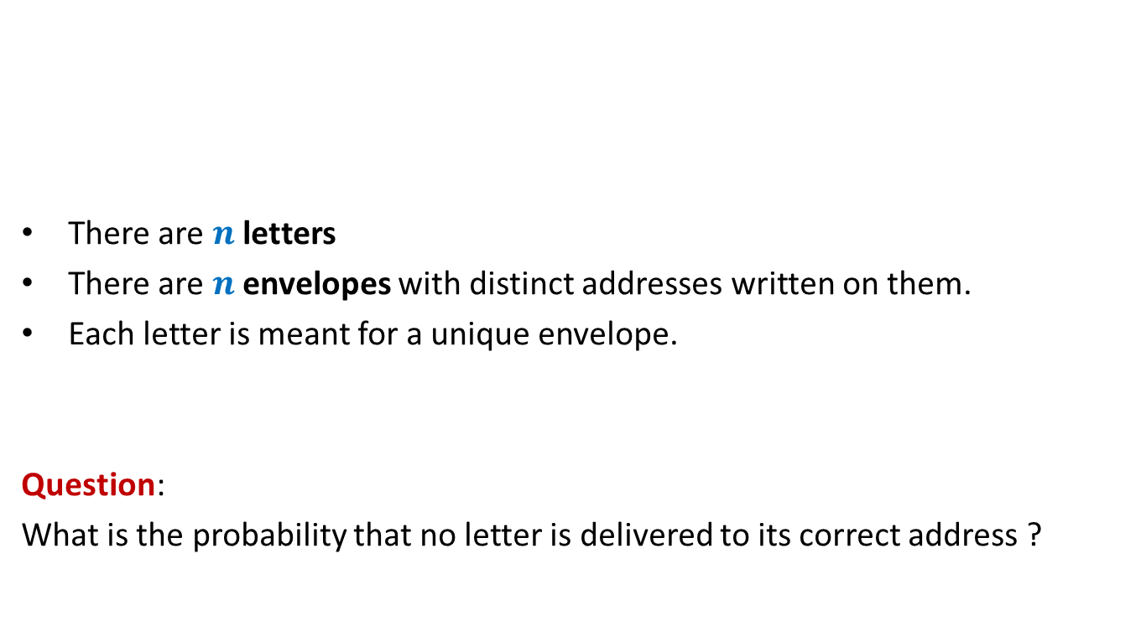






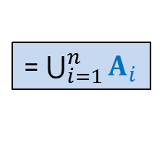
Letters and envelopes
$$\frac{1}{2}$$
There are $n$ letters
There are $n$envelopes with distinct addresses written on them.
Each letter is meant for a unique envelope.
Question:
What is the probability that no letter is delivered to its correct address ?
$n$ = $2$
$n$ = $3$
$$\frac{1}{3}$$
$n$ = $4$
$$\frac{3}{8}$$
Letters are assigned randomly uniformly to the envelopes, one by one.
Event $B$ :
No letter is placed in its envelope.
Event $B^{c}$ :
At least one letter is placed in its envelope.
= $\bigcup_{i=1}^{n}{A_{i}}$
Event $A_{i}$ :
$i$ th letter is placed in its envelope.

Slide 14



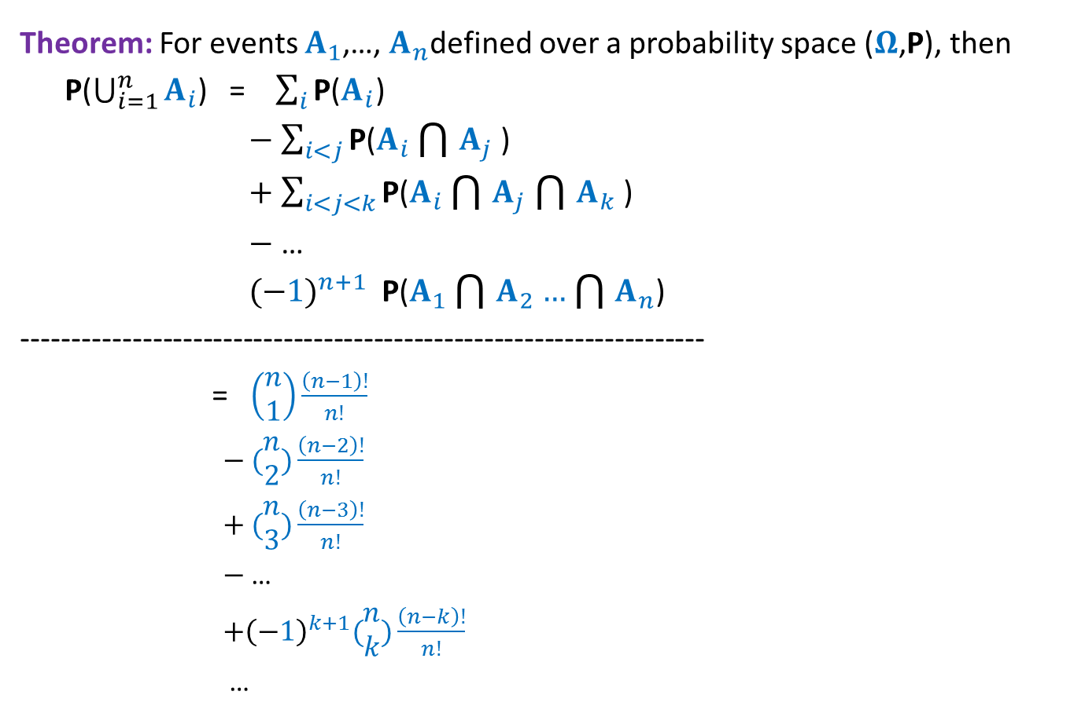




Letters and envelopes
Theorem: For events $A_{1}$,…, $A_{n}$defined over a probability space ($Ω$,P), then
P($\bigcup_{i=1}^{n}{A_{i}}$) = $\sum_{i}{\text{P}\text{(}A_{i}\text{)}}$
$−$ $\sum_{i<j}{\text{P}\text{(}A_{i}\bigcap{A_{j}}\text{)}}$
$+$ $\sum_{i<j<k}{\text{P}\text{(}A_{i}\bigcap{A_{j}}\bigcap{A_{k}}\text{)}}$
$−$ …
${(−1)}^{n+1}$ $\text{P}\text{(}A_{1}\bigcap{A_{2}}…\bigcap{A_{n}}$)
--------------------------------------------------------------------
= $\left(\begin{matrix}n \\ 1\end{matrix}\right)\frac{\left(n−1\right)!}{n!}$
$−$ $(\begin{matrix}n \\ 2\end{matrix})\frac{\left(n−2\right)!}{n!}$
$+$ $(\begin{matrix}n \\ 3\end{matrix})\frac{\left(n−3\right)!}{n!}$
$−$ …
${+\left(−1\right)}^{k+1}(\begin{matrix}n \\ k\end{matrix})\frac{\left(n−k\right)!}{n!}$
…
P$(B^{c}$)
$$1$$
$$−\frac{1}{2!}$$
$$+\frac{1}{3!}$$
$≈1−1/e$ for large $n$
…
P($B$) $≈1/e$
$${\left(−1\right)}^{k+1}\frac{1}{k!}$$
…

Slide 15

Homework
What is the probability that exactly $k$letters are placed correctly ?

Slide 16
Recruitment Problem

Slide 17

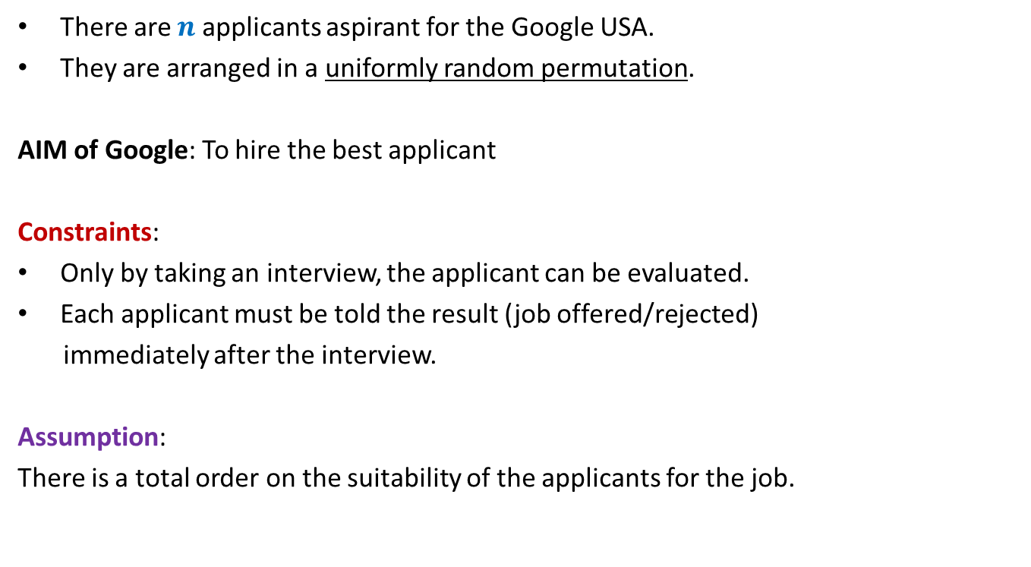
There are $n$ applicants aspirant for the Google USA.
They are arranged in a uniformly random permutation.
AIM of Google: To hire the best applicant
Constraints:
Only by taking an interview, the applicant can be evaluated.
Each applicant must be told the result (job offered/rejected)
immediately after the interview.
Assumption:
There is a total order on the suitability of the applicants for the job.
Interview the first $k$ applicants and discard all of them.
Keep on interviewing the rest of the candidates, and as soon as you find someone better than the “best among the first $k$”, offer him/her the job.

